Slide 1
Invoice Matching Application
- Suresh CHINNA SHANMUGAM

Slide 2
Agenda
Project Flow – Load Input Data-> Invoice Processing -> Matching/Unmatching -> Output Rendering using Python API
Introduction
Implementation Details
Results
Future
Work
Requirement Analysis
Data Sources
Design Approach
Evaluation
Conclusion
Notes:
Project’s Agenda is as follows:
In the introduction, the motivation factors for choosing this subject will be discussed. Then thesis context and problem statement are accompanied by contributions to this research are described.
In the related study provides a summary of Invoice Matching Application flow.
Next Data Sources section, Information regarding the input data sources that were used in this project analysis can be found.
In Design approach, The architectural design and data pipeline are defined.
In the implementation section, the input data used, algorithms or project implementation are described. In addition to preprocessed data preparation, later how the model sent to corresponding methods to get the desired functional outcomes.
In the result section, based on the input data source, we can see the implementation of matching and unmatched invoice and payment processing association using Lettering and recovery used to achieve the desired results..
The assessment section discusses the validation of results performed to meet the functional requirements.
After that, conclusion of this project – Future work & Enhancement scope.
Finally in the future scope, this project base has potential to enhance further to meet all the future requirements.

Slide 3
Introduction
Invoice Processing
Motivation
The key focus area is to implementation of Invoice Matching(Processing) Application using Python
Context
The Process logic, Design Approach, Implementation and test execution, deployment and results validation are key activities to meet the functional requirements.
Problem Statement
Required to find the list of Invoices/payments and that are matched or Balanced between Debit and Credit amounts, and list the remaining Unmatched records.
Contribution
Implementation of business process logic using python, database and Flask API

Slide 4
Requirement Analysis
Requirement Analysis
High level Requirements – To create Matched Invoices with the payment (Types) data based on Debit and credit amounts – The Balanced amounts.
Technological Specification: Pure Python, API Mode, One backend Table – Hence Opted for MySQL DB to store the required data into Database.
Meta Data/ Schema for the tables
The Key Requirements from User(Operado)
Create an instance to feed the table. The video does not show the addition of Invoice, but it will be necessary to envisage it for the continuation
Filter results based on instance data
the possibility of associating instances of payment and invoice type when the amount is matching
ex : Invoice in the amount of € 20 and a payment of € 2
Assumptions:
NO Specific Data format given, Hence Created CSV file format as input from the Jpeg Sample Data provided by Operado for the current project implementation.
No Technological Specification to use on Python API – Hence Opted for Python Flask to display the output data in the HTML page from the processed Json Files for all the matched and Invoices invoices
No Specific requirement on Unmatched records, hence added additional Enhancements
Additional Enhancements:
– Additional Implementation to display All Unmatched Invoices order by Recover (Due, Not Due and Blank)
- Implementation on to display the summary of Unmatched records based on Recovery (Debit and Credit Summary)

Slide 5
Data Source – Input and Output
Data Source – From the Jpeg Image provided by Oparedo used as Input to Create CSV file format and created output matched and unmatched data into Json Files and loaded in HTML page using Python Flask API methods.
Output Data, Processed(Matched, Unmatched) in Json Format
CSV File – Input Data
Loaded into MySQL DB - IINVOICETAB
56 Samples
Converted to Data Frame
Loaded into Python Flask API (Front End)

Slide 6
Design Approach

Slide 9
Implementation

Slide 12
Results

Slide 13
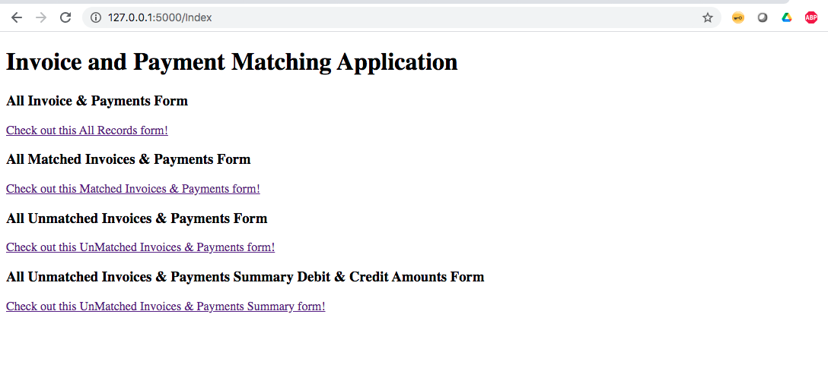
Index Page - Front End HTML
Results Displayed in Front End – Index Page for Invoice and Payment Matching Application: Rendered using Python Flask API - with POST, GET methods.
URL:
Index Page: http://127.0.0.1:5000/Index
Index Page Includes List of Operations
All Invoices and Payment Form
All Matched Invoices & Payments Form
All Unmatched Invoices or Payments Form
All Unmatched Invoices & Payments Summary – Debit & Credit Amounts Form

Slide 14
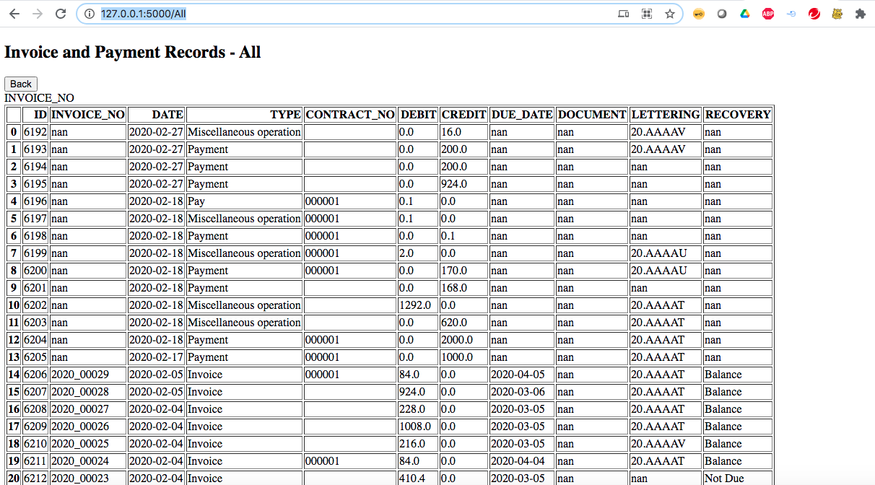
All Records Page - Front End HTML
All Records Page – List of all the data records loaded to database from the Input CSV data – Rendered using Python Flask API - with POST, GET methods.
URL: All records Page:
http://127.0.0.1:5000/All
All Records - List of Operations
List of All the records from the database table – INVOICETAB
The data pulled from INVOICETAB, converted to Data frame -> Json file -> then rendered json file o html

Slide 15
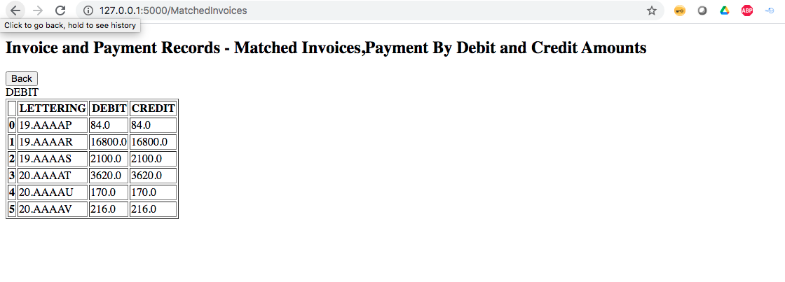
Matched Invoices Page - Front End HTML
Matched Invoices Page – List of all the Matched Invoices data records loaded to database from the Input CSV data – Rendered using Python Flask API - with POST, GET methods.
URL: Matched Invoices Page:
http://127.0.0.1:5000/MatchedInvoices
All Records - List of Operations
List of All matched Invoices and Payments by Debit and Credit Amounts processed from the data retrieved from the database table – INVOICETAB
The matched Invoice data pulled from INVOICETAB, converted to Data frame -> Json file -> then rendered json file o html

Slide 16
All Records Page - Front End HTML
All Records Page – List of all the data records loaded to database from the Input CSV data – Rendered using Python Flask API - with POST, GET methods.
URL: All records Page:
http://127.0.0.1:5000/All
All Records - List of Operations
List of All the records from the database table – INVOICETAB
The data pulled from INVOICETAB, converted to Data frame -> Json file -> then rendered json file o html

Slide 17
All Records Page - Front End HTML
All Records Page – List of all the data records loaded to database from the Input CSV data – Rendered using Python Flask API - with POST, GET methods.
URL: All records Page:
http://127.0.0.1:5000/All
All Records - List of Operations
List of All the records from the database table – INVOICETAB
The data pulled from INVOICETAB, converted to Data frame -> Json file -> then rendered json file o html

Slide 18
Future Scope
Within Scope
Matched Invoices
Invoice: Debit type transaction Payment: Credit type transaction Transaction association (lettering) is only done between balanced credit and debit type transactions Example: Ex:
1 invoice of 10€ and 1 payment of 10€.
2 invoices of 10€ and 1 payment of 20€.
2 invoices of 10€ and 2 payments of 10€.
1 invoice of 10€ and 2 payments of 5€ each
Out of Scope:
No 30way matching between Order, Invoice, and Payments - Requirement to match only between DEBIT and credit amounts.
No Invoice detail(line) level matching (SKUs, Quantities etc)
Additional Enhancements Included:
Unmatched Invoices/payments of Debit & Credit Amounts – Order by Recovery ((Due. - Echu, Not Due – Non-échu, Blank)
Unmatched Summary of DEBIT & Credit Amounts – Group by Recovery. (Due. - Echu, Not Due – Non-échu, Blank)
Further Enhancements Scope:
This project can be enhanced for future requirements
This can be enhanced for future requirements like - 3 or 4-Way Matching - If additional details are provided ( Order Information, Shipment, Invoice and Payments)
Matched and Unmatched Detail level Matching ( SKUs, and Quantities)

Slide 19
Thank you
- Suresh CHINNA SHANMUGAM
- Email: suresh.cs0524@gmail.com
- Mobile: +33 758072207

